Slide 1

PROJECT:DOOR LOCK WITH PASSWORD SYSTEM
Zeynep Gizem ÇETİNCİ YALÇIN

Slide 2
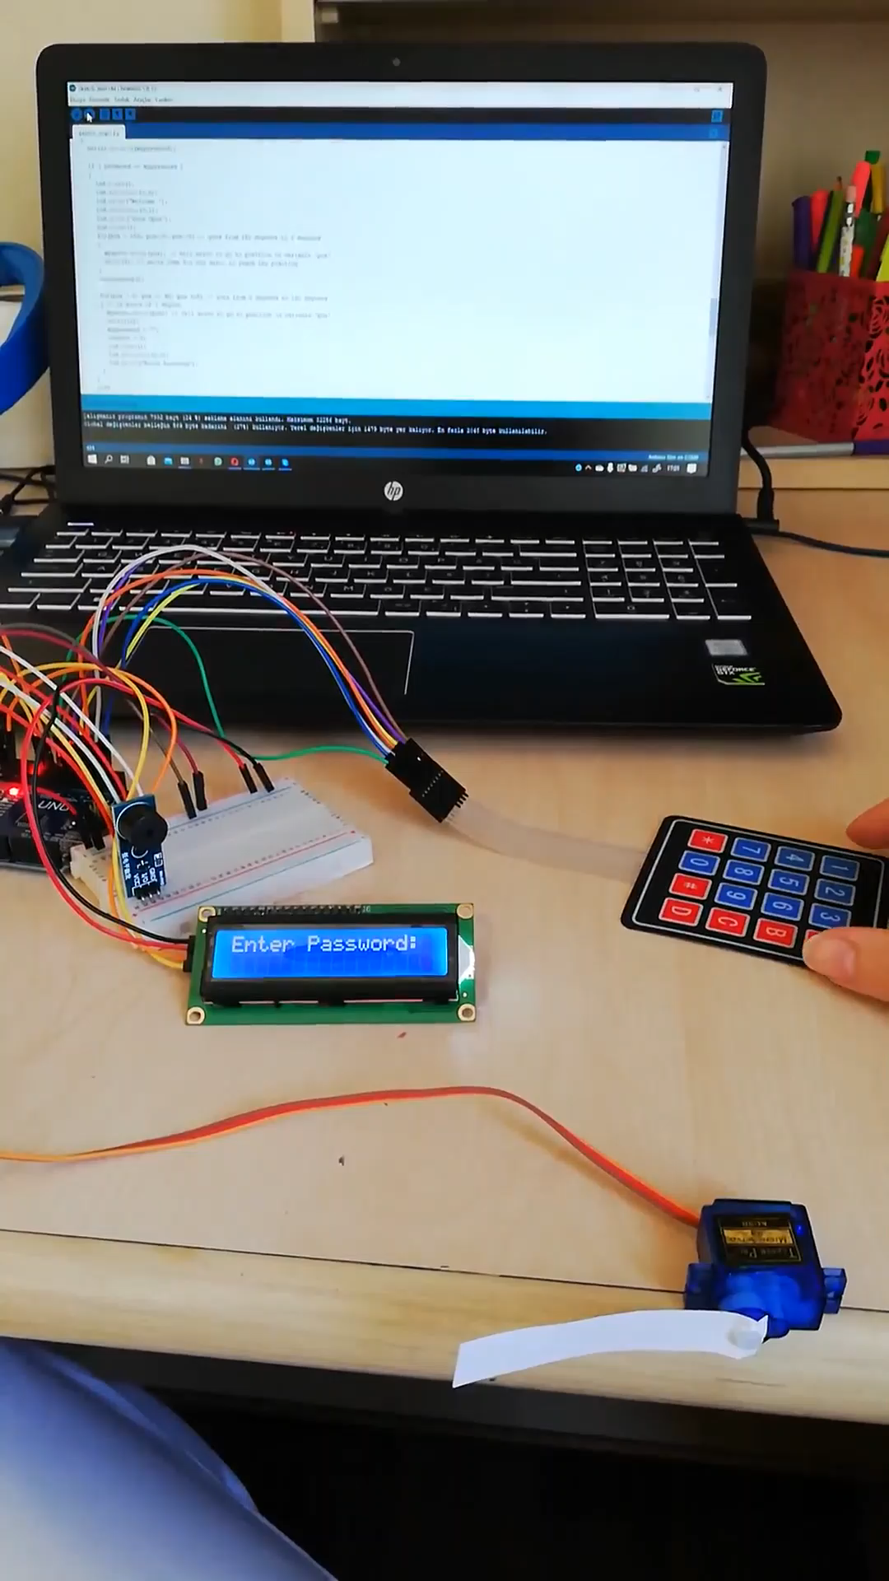
DOOR LOCK WITH PASSWORD SYSTEM

Slide 3
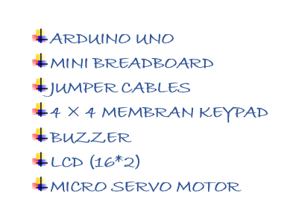
DOOR LOCK WITH PASSWORD SYSTEM

Slide 4
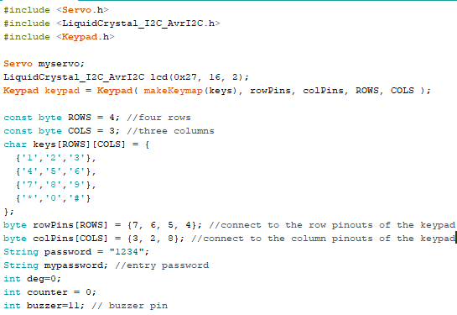
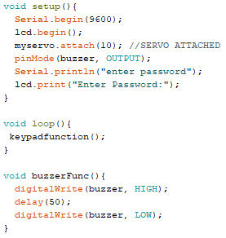
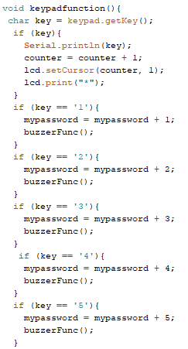
DOOR LOCK WITH PASSWORD SYSTEM

Slide 5
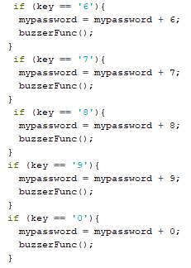
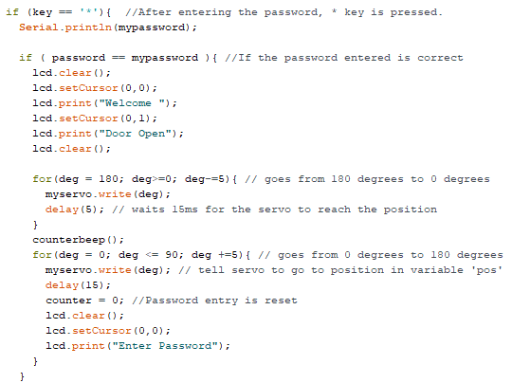
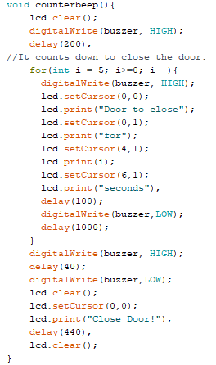
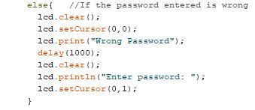
DOOR LOCK WITH PASSWORD SYSTEM

